Slide 1



Maine SIM Self-Evaluation
David Hanig
Project Director
The Lewin Group

Slide 2
Today’s Agenda
Evaluation Overview and Activities to Date
Dashboard Reporting Template
Public Comment
“Nothing About Us, Without Us”

Slide 3
Setting the Stage: Maine SIM Self Evaluation
Current SIM work builds on decades of reform efforts in Maine
SIM funding provided Maine the opportunity to knit together these efforts to bend the health care curve, improve quality and outcomes, and increase patient satisfaction
Lewin is partnering with Maine DHHS to conduct a multi-year evaluation of SIM with 3 key components:
  Implementation/Process Evaluation
  Cost Effectiveness Evaluation
  Impact/Effectiveness Evaluation
“Nothing About Us, Without Us”

Slide 4
Components of the Maine SIM Evaluation
Process / Implementation
Cost Effectiveness
Analyze claims data to determine changes in:
Impact and Effectiveness
Analyze claims and survey data to determine changes in:
Surveys and focus groups with providers, consumers and stakeholders to assess:
Health care service utilization
Health care expenditures
Returns on SIM investments (e.g., Health Homes, Behavioral HHs and Accountable Communities)
Quality of care
Patient experience
Adherence to best practices
Measurable outcomes and
Perceptions of SIM implementation
Challenges and barriers
Opportunities for improvement
“Nothing About Us, Without Us”
Reporting
Quarterly, Annual, and Regular Steering Committee and Subcommittee Updates
Facilitated Discussions of Early Learnings and Rapid Cycle Improvements
Evaluation Subcommittee
Provide strategic insight into evaluation and reporting
Support the development of sustainable research collaborative

Slide 5
SIM Core Metrics and Supplemental Measures Domains
Core Metrics
Supplemental Measures
Emergency Department Utilization
Readmissions
Imaging
Fragmented Care
Mental Health
Patient Experience and Engagement
Obesity
Diabetes
Care Transitions
Care Coordination
Physical Health / Behavioral Health Integration
Integration Healthcare systems/ Public health/ Community care
Patient/Family-centered care
Prevention Quality Indicators (PQIs)

Slide 6
Research Questions: Implementation/Process Evaluation
“Nothing About Us, Without Us”
  How do enrollees, providers and stakeholder perceive SIM implementation?
  What factors influence the adoption and spread of model enhancements?
  To what extent are model components implemented consistently and with fidelity?
  What system, practice, and beneficiary level factors are associated with the model outcomes?

Slide 7
Approach: Implementation/Process Evaluation
Key Informant and Provider Interviews
  Lewin partnering with Crescendo Consulting Group (Portland)
  Crescendo to conduct provider surveys and key informant interviews
  Questions will:
    Gather perspectives on implementation process for each initiative
    Identify recommendations for improvement.
Enrollee Survey
  Lewin partnering with Market Decisions (Portland)
  Phone surveys with approximately 1500 enrollees
  Questions based on the CAHPS survey and supplemented with questions specific to the ME SIM initiatives

Slide 8
Approach: Cost Effectiveness Evaluation
Cost-effectiveness study will measure the change in per-member-per-month (PMPM) expenditures from health care claims data for members engaged in SIM relative to a comparison group
Lewin will apply risk adjusters to address variation in severity of disease.
Cost effectiveness study will:
  Evaluate changes in service utilization trends and associated costs
  Analyze cost savings and return on investment (ROI) linked to the SIM initiatives
Changes in aggregate expenditures will be analyzed using a difference in difference model.
Data analyzed with EBM Symmetry® and findings presented using Tableau® software
“Nothing About Us, Without Us”

Slide 9
Key Research Questions: Impact &
Effectiveness Evaluation
  Does the model lead to improvements in care coordination and less fragmentation of care and, if so, for what populations and to what extent?
  Does the model lead to improvements in quality and processes of care and, if so, to what extent?
  To what extent does the model improve the level of integration of physical and behavioral health across Maine’s health care system?
  Does the model lead to improvements in beneficiary health, well-being, function, and reduced health risk behaviors, and if so, to what extent?
  Does the model lead to improved beneficiary experiences of care and perception of services and, if so, to what extent?
  What system, practice, and beneficiary level factors are associated with the model outcomes?
“Nothing About Us, Without Us”

Slide 10
Method: Impact & Effectiveness Evaluation
Integrate qualitative and quantitative methods previously described to analyze relevant data and answer the key research questions of this study
Separate investigations will be conducted to assess the individual impact of four key SIM interventions: Stage A Health Homes, Stage B Health Homes, Patient Centered Medical Homes, and MaineCare Accountable Communities.
Additional investigations may be used to explore the impact of other interventions and related SIM activities beyond those specified above (e.g. the Community Health Worker or Community Care Team pilots)
“Nothing About Us, Without Us”

Slide 11
Reporting
Quarterly Dashboard (Demonstration to follow)
  Cost-effectiveness and impact evaluation measures, with others phased in over time
  To be reviewed by SIM Partners prior to broader dissemination
  User-friendly to decision-makers and external audiences
Quarterly Presentations to Steering Committee
  Status update on evaluation
  Facilitated discussions of rapid cycle improvements and development of learning opportunities
Annual Report and Presentation to Steering Committee
  Annual report will be drafted for review and input by Evaluation Subcommittee and approved by ME DHHS
  Presentation of findings will occur in month following submission of the Annual Report
“Nothing About Us, Without Us”

Slide 12
Evaluation Activities to Date
Launched Evaluation Subcommittee
Conducted preliminary meetings with SIM partners to review current processes and ensure alignment of work
Conducted preliminary meetings with Muskie and RTI to begin establishing coordination for evaluation activities
Drafted Evaluation Plan
Participated in Steering Committee and SIM Partner Meetings
Obtained MaineCare, commercial and attribution data and began analysis
Developed draft of quarterly dashboard reporting tool
“Nothing About Us, Without Us”

Slide 13
Today’s Agenda
Welcome and Introductions
Evaluation Overview and Activities to Date
Dashboard Reporting Template
Public Comment
“Nothing About Us, Without Us”

Slide 14
Quarterly Dashboard Demonstration
Following is a demonstration of the Tableau tool, to be used as the quarterly dashboard reporting under the SIM Self-Evaluation.
Note that the data in this demonstration is made-up – strictly to illustrate the look and feel of the tool.
The dashboard portal home page will list all of Maine’s core metrics supported by claims data. (Vital signs measures, like BMI, must be addressed through other vehicles.)

Slide 15
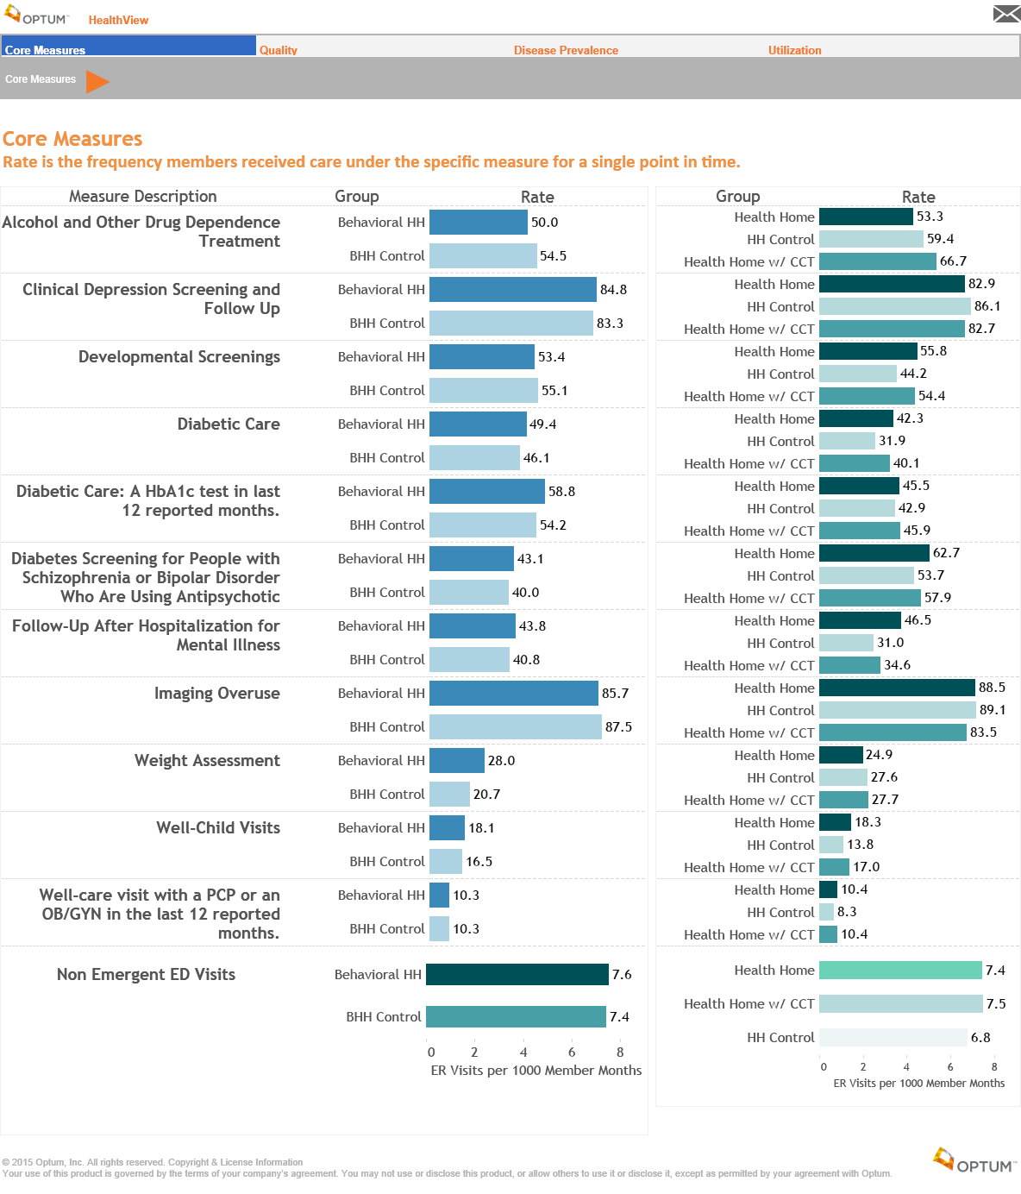

Slide 16
Quarterly Dashboard Demonstration
The dashboard will allow users to view trends over periods of time and to examine trends for different measures and populations
The following page shows per capita spending over time for people in Behavioral Health Homes. The blue line represents the control group

Slide 17
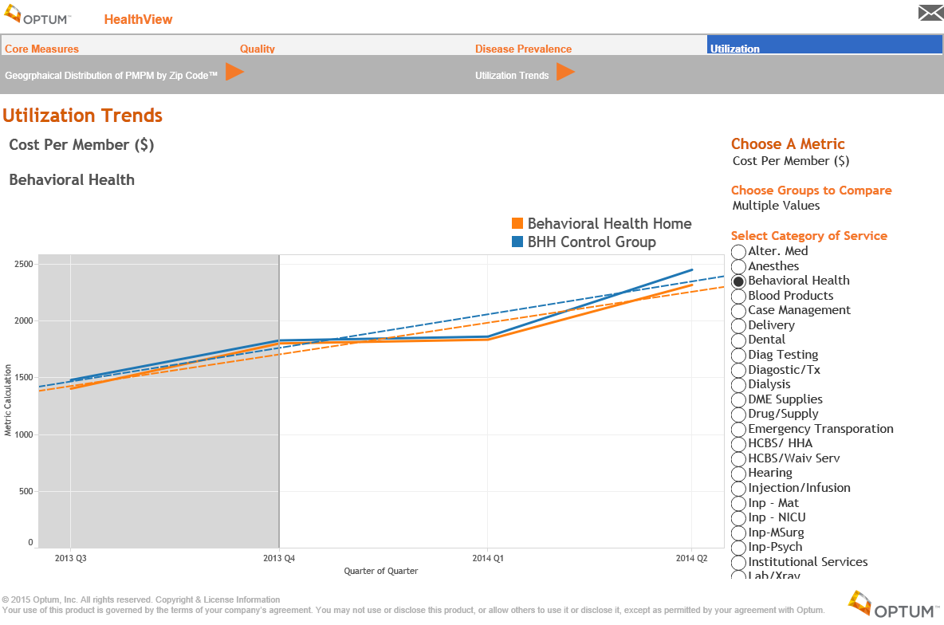

Slide 18
Quarterly Dashboard Demonstration
Users can view trends for other programs by checking options in drop-down menus.

Slide 19
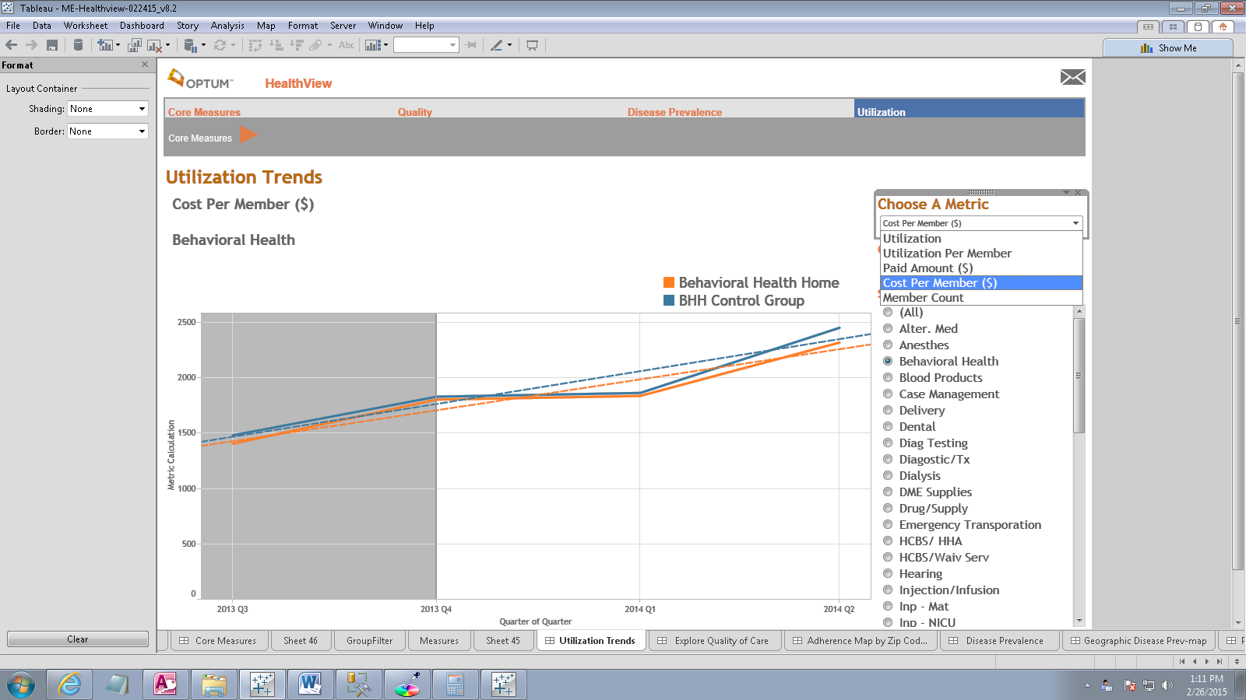
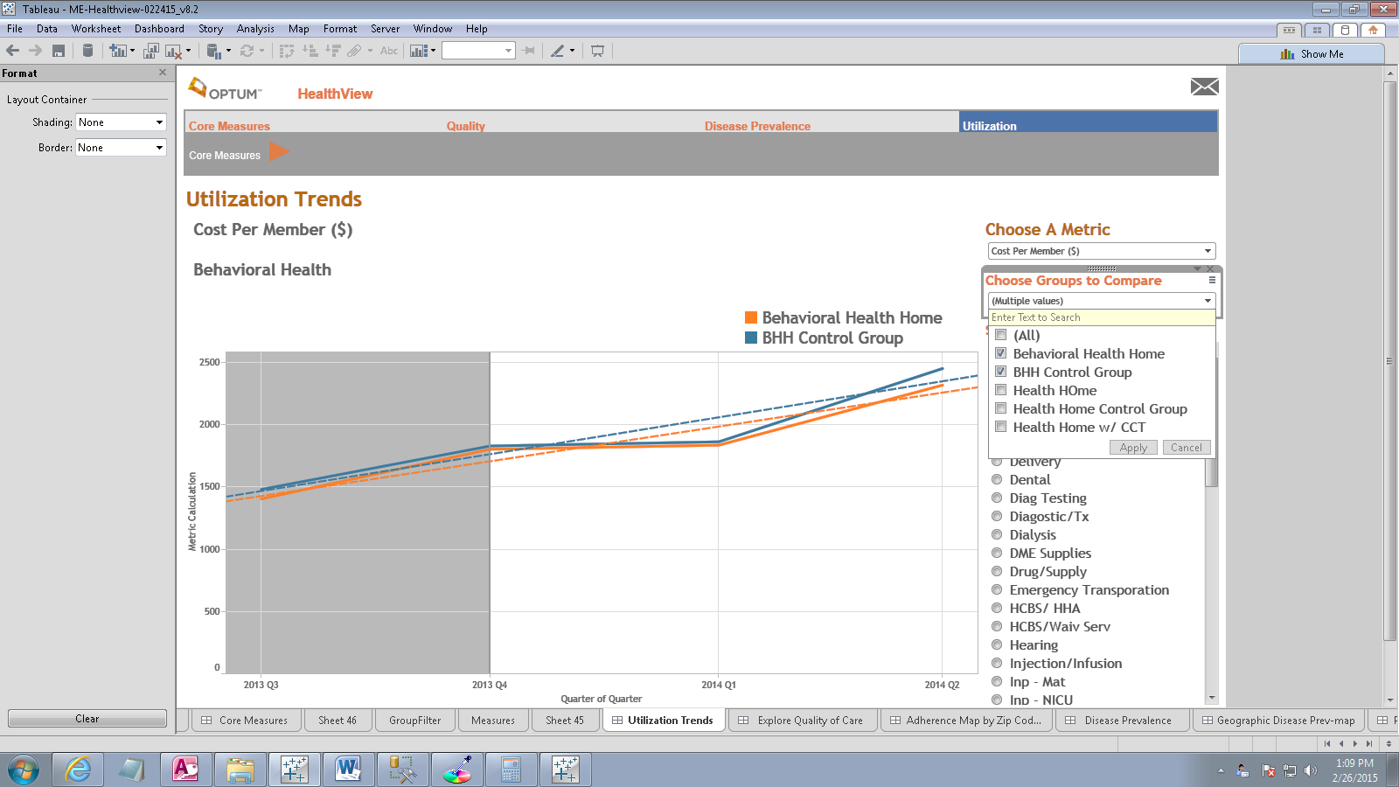

Slide 20
Quarterly Dashboard Demonstration
The dashboard will also display data geographically so a viewer can identify areas of the state where performance differs from the average.

Slide 21
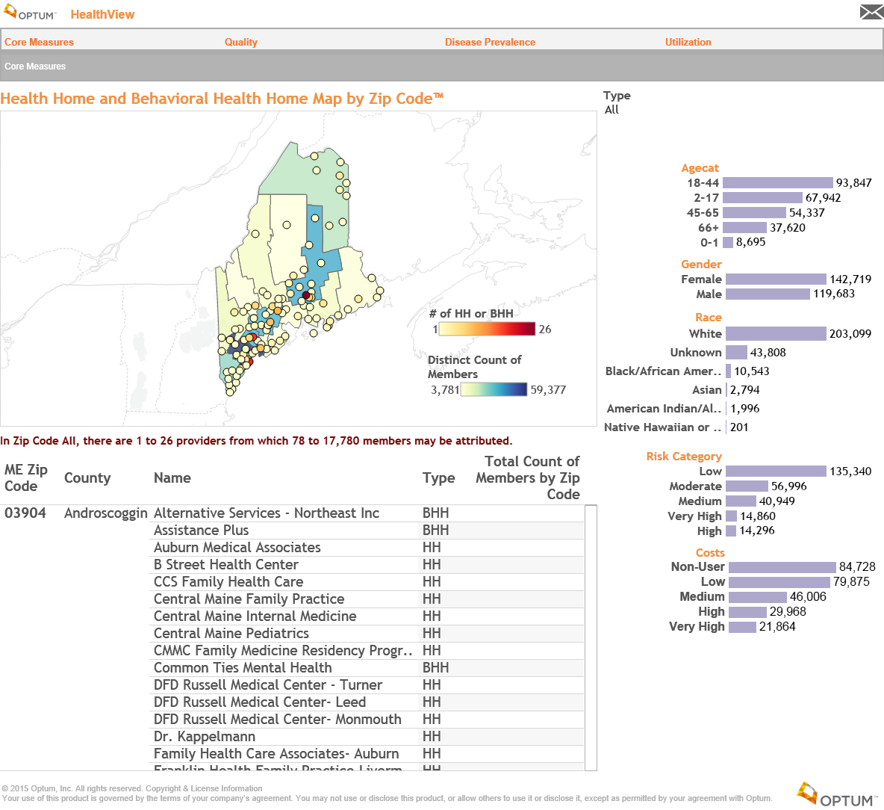

Slide 22
Quarterly Dashboard Demonstration
Viewers can “drill down” simply by clicking on specific site or county.

Slide 23
Today’s Agenda
Welcome and Introductions
Evaluation Overview and Activities to Date
Dashboard Reporting Template
Public Comment
“Nothing About Us, Without Us”

